Slide 1
I.C. ENGINE

Slide 2
HEAT ENGINE
I. C. ENGINE
E. C. ENGINE
Combustion of fuel takes place inside the cylinder.
Compact in size.
Low initial Cost.
Fuels are costly.
Suitable for mobile application.
Combustion of fuel takes place outside the cylinder.
Large in size.
More initial cost.
Cheaper fuels may be used.
Less suitable for mobile applications.

Slide 3
WORKING OF RECIPROCATING ENGINE

Slide 4
WORKING OF RECIPROCATING ENGINE

Slide 5
MAIN COMPONENTS OF I. C. ENGINE AND THEIR FUNCTIONS.

Slide 6
4 S PETROL
CYLINDER
WATER JACKET
PISTON PIN
PISTON RING
PISTON
CONNECTING ROD
FRAME
CRANK

Slide 7
ROCKER ARM
4 S PETROL
PUSHROD
SPARK PLUG
SPRING
CYLINDER HEAD
INLET VALVE
EXHAUST VALVE
CAM FOLLOWER
CAM
LUBRICATING OIL

Slide 8
ROCKER ARM
4 S PETROL
PUSHROD
SPARK PLUG
SPRING
CYLINDER HEAD
CYLINDER
WATER JACKET
INLET VALVE
EXHAUST VALVE
CAM FOLLOWER
CAM
PISTON PIN
PISTON RING
PISTON
CONNECTING ROD
FRAME
CRANK
LUBRICATING OIL

Slide 9
Engine parts and their functions
Frame:- Consists of bed plate, crank case, also supports the different movable ports.
Bed plates are rigidly fix up with the foundations.
Lower parts of the crank case contains oil for the lubrication purpose.
(2) Cylinder :- Single cylinder engine has a single cylinder. Cylinder contains cylindrical bores, opening for valve mechanisam, passage for cooling water known as water jackets.
(3) Cylinder Block:- Multiple cylinder engine has cylinder block. Separate cylinder head is fit over the cylinder block with stud and nuts. Cylinder block is made up from the cast iron.

Slide 10
(4) Cylinder Head:- Top of the engine cylinder is
close by a cover known as cylinder head.
It contain inlet and exhaust valves.
(5) Piston: Gas tight movable cylindrical part which
Reciprocate in the cylinder. Piston rings are provide
around the piston to prevent the leakage of the hot
High pressure gases. Made up from aluminium alloy.
(6) Connecting Rod:- Connects the piston and crank
Shaft. Small end of the connecting rod is fit with the
Piston pin or gudgeon pin. Big end of the connecting
rod is fit with the crank shaft by crank pin.
Main function is to convert the reciprocating motion of piston in to rotary motion of the crank shaft.

Slide 11
(7)Crank Shaft:- Principal rotating part of the engine. Crank
shaft is support on to main bearings. Mechanical work
is available at the crank shaft of the I C engine. Drives various
accessories of the I C engine like as lubricating oil pump,
Cooling water pump, dynamo, cam shaft, spark distributer etc.
Fly Wheel is mount on to the crank shaft made up from
Forge steel.
(8) Valve Gear:- Combination of the parts which control the
Admission of fresh charge into cylinder and discharge of
Exhaust gases from the cylinder is term as valve gear.
Consists of cam shaft, cams, followers, push rods, rocker
arms, springs, valves. Valves are made up from nickel steel
Or the chrome steel.
(9) Cam Shaft:- operates the valve gear mechanisam. Driven
by the crank shaft through timing gear. Rotates at the half
of the crank shaft speed because each valves needs to be
Operate once in two revolution of the crank shaft.

Slide 12
(10) Fly Wheel:- Heavy Wheel which is fit on to crank shaft. Minimize the fluctuation of cyclic variation in the speed by storing the energy during expansion stroke and by realizing the energy during the other stroke.
(11) Carburetor:- Provide in to the petrol engine for proper mixing of the air and petrol.
(12) Spark Plug:- Provide in to the petrol engine to provide spark to ignite air-fuel mixture. Fit in to the cylinder head.
(13) Fuel Injector:- Provide in to the diesel engines. Use to inject diesel in the form of fine
Atomize spray under the pressure.

Slide 13
Fuel Pump:- Pumps the fuel from storage tank to injector at the high pressure in to the diesel engine. Pumps the petrol from storage tank to carburetor if the storage tank is below the carburetor level in to the petrol engine.

Slide 14
Important Terminology:-
Dead center:- Define as positions occupy by the piston at
the end of the stroke where crank and center line of the
connecting rod is in a straight line.
(2) Top Dead Centre (TDC):- Top most position of the piston
on cylinder head side in to the vertical engines.
(3) Bottom Dead Centre (BDC):- Bottom most position of the
piston on to the crank shaft side in to the vertical engines.
(4) Inner Dead Centre (IDC):- Inner most position of the piston
on to the cylinder head side in to the horizontal engines.
(5) Outer Dead Centre (ODC):- Outer most position of the
piston on crank shaft side in to the horizontal engine.
(6) Stroke:- Traveling of the piston from one dead center to the
second dead center is term as the stroke.
(7) Swept Volume:- Volume swept away by the piston in one
stroke. D is the diameter of the cylinder or the bore and L is
the stroke length then swept volume Vs can be write like as

Slide 15

In the Equation form as below:
Vs = $\frac{∏}{4}$ $D^{2}$. L
(8) Clearance Volume:- Volume entrap between piston and the cylinder head when piston is at TDC or IDC is known to be as clearance volume denote by Vc.
(9) Stroke length:- Distance travel by a piston from one dead center to second dead centre is called stroke length. Equal to twice the crank radius or crank throw.
Stroke Length (L) = 2 x crank radius
(10) Piston Speed:- During one stroke piston travels a distance equal to stroke length and in one revolution of crank shaft piston completes two stroke.
Piston speed is to be written as
Piston speed = 2LN
N is the speed of the engine.

Slide 16

(11) Compression Ratio:- Ratio of the volume at the beginning of the compression stroke to the volume at the end of the stroke.
Volume at the beginning of the compression stroke will be : Vs + Vc
Volume at the completing of the compression stroke will be : Vc
So that Compression ratio is equal to $\frac{V_{S}+V_{C}}{V_{C}}$
Petrol Engine Compression ratio value vary from 5 to 8
Diesel Engine Compression ratio value vary from 16 to 22.

Slide 19
Classification Of I.C. Engine
1. Cycle Of Operation
Two Stroke Cycle Engine
Four Stroke Cycle Engine

Slide 20
Classification Of I.C. Engine
2. Thermodynamic Cycle Of
Combustion
Otto Cycle Engine
Diesel Cycle Engine
Duel Cycle Engine

Slide 21
Classification Of I.C. Engine
3. Arrangement Of Cylinder/ piston
Horizontal Engine
Vertical Engine
V-Type Engine
Y- type engine
Radial Engine

Slide 22
Classification Of I.C. Engine
4. Arrangement Of Cylinder/ piston
Opposed cylinder engine
Opposed piston engine
In-line engine
Deltic Engine

Slide 23
Vertical In line Engine

Slide 24
Horizontal Opposed cylinder engine

Slide 25
V-Type Engine

Slide 26
Radial Engine

Slide 27
Vertical Opposed piston engine

Slide 28
Classification Of I.C. Engine
4. Number Of Cylinders
Single Cylinder Engine
Multi Cylinder Engine

Slide 29
Classification Of I.C. Engine
5. Action Of Product Of Combustion Upon The Piston
Single Acting Engine
Double Acting Engine

Slide 30
Classification Of I.C. Engine
6. Speed Of The Engine
Low Speed Engine
Medium Speed Engine
High Speed Engine

Slide 31
Classification Of I.C. Engine
7. Method Of Igniting Fuel
Spark Ignition System
Compression Ignition System
Electronics Ignition System

Slide 32
Classification Of I.C. Engine
8. Method Of Cooling The Cylinder
Air Cooled Engine
Water Cooled Engine

Slide 33
Classification Of I.C. Engine
9. Method Of Governing The Engine
Hit And Miss Governing Engine
Quantity Governing Engine
Quality Governing Engine

Slide 34
Classification Of I.C. Engine
10. Method Of Fuel Supply To The Engine Cylinder
Carburettor Engine
Air Injection Engine
Solid Or Airless Injection Engine

Slide 35
Classification Of I.C. Engine
11. Suction Pressure
Naturally Aspirated Engine
Super Charged Engine

Slide 36
Classification Of I.C. Engine
12. Uses/ application
Stationary Engine
Portable Engine
Automobile Engine
Tractor Engine
Aero Engine
Marine Engine

Slide 37
Automobile engine

Slide 38
Automobile engine

Slide 39
Aero engine

Slide 40
Railway/ locomotive engine

Slide 41
Marine engine

Slide 42
Tractor engine

Slide 43
TERMINOLOGY OF
I.C. ENGINE
WHAT IS DEAD CENTER?

Slide 44
Dead center:
DC
Extreme position of the piston
DC
Piston stops for fraction of second
Piston changes the direction of movement.

Slide 45
TDC
In a vertical axis engine top most position of the piston is T.D.C.

Slide 46
In a vertical axis engine bottom most position of piston is B.D.C.
BDC

Slide 47
Outer Dead Center:
In a horizontal axis engine the outer most position (towards head) of the piston is O.D.C.

Slide 48
I.D.C.
In a horizontal axis engine inner most position ( towards crank ) of piston is I.D.C.

Slide 49
What is Stroke ( Stroke Length ), L?
Distance traveled by piston, from one dead center to other dead center, is called STROKE.
stroke = distance from TDC to BDC or BDC to TDC
( for Vertical engine)
stroke = distance from ODC to IDC or IDC to ODC
( for Horizontal engine)
stroke ( L ) = 2 x crank radius ( r )

Slide 50
TDC
stroke
BDC

Slide 51
AREA OF CYLINDER ( AREA OF PISTON )
Where,
D = Inside Diameter of Cylinder.
= Outside Diameter of Piston.
= Cylinder Bore.
Swept Volume ( Stroke Volume ) = Area of Cylinder * Stroke Length.
Clearance Volume = Area of Cylinder * Clearance Length.
Total Volume of Cylinder = Swept Volume + Clearance Volume.

Slide 52
Working of 4 Stroke Cycle
Petrol Engine

Slide 53
S
R
N
O
STROKE
INLET
VALVE
EXHAUST
VALVE
REMARK
Crank rotated by external force F. piston moves from TDC to BDC. charge taken inside the cylinder
S
U
C
T
I
O
N
OPEN
CLOSE
1

Slide 54
S
R
N
O
STROKE
INLET
VALVE
EXHAUST
VALVE
REMARK
Crank rotated by external force F. piston moves from BDC to TDC. charge compressed inside the cylinder
2
COMP.^{N}
CLOSE
CLOSE

Slide 55
S
R
N
O
STROKE
INLET
VALVE
EXHAUST
VALVE
REMARK
High pr. high temp. charge is ignited by spark. Combustion will produce high pressure high temp. hot gases
At the
end of
comp^{n}
stroke
CLOSE
CLOSE

Slide 56
S
R
N
O
STROKE
INLET
VALVE
EXHAUST
VALVE
REMARK
High pr. high temp. hot gases will do work on piston. hence power P will be available at crank shaft.
Power
or
Expa.^{n}
3
CLOSE
CLOSE

Slide 57
S
R
N
O
STROKE
INLET
VALVE
EXHAUST
VALVE
REMARK
crank rotated by external force F. Piston moves from BDC to TDC. Waste gases or weak hot gases is exhausted by piston.
Exhaust
or
scavengin^{g}
4
CLOSE
OPEN

Slide 58
Prepared By : Prof. N. K. Chavda, Assistant Professor , Dept. of Mech. Engg.

Slide 59
Working of 4 Stroke Cycle
Diesel Engine

Slide 60
S
R
N
O
STROKE
INLET
VALVE
EXHAUST
VALVE
REMARK
Crank rotated by external force F. piston moves from TDC to BDC. only air taken inside the cylinder
S
U
C
T
I
O
N
OPEN
CLOSE
1

Slide 61
S
R
N
O
STROKE
INLET
VALVE
EXHAUST
VALVE
REMARK
Crank rotated by external force F. piston moves from BDC to TDC. air compressed inside the cylinder
2
COMP.^{N}
CLOSE
CLOSE

Slide 62
S
R
N
O
STROKE
INLET
VALVE
EXHAUST
VALVE
REMARK
Diesel, in atomized form is injected, in high pr high temp. air, is ignited due to high temp. Combustion will produce high pressure high temp. hot gases
At the
end of
comp^{n}
stroke
CLOSE
CLOSE

Slide 63
S
R
N
O
STROKE
INLET
VALVE
EXHAUST
VALVE
REMARK
High pr. high temp. hot gases will do work on piston. hence power P will be available at crank shaft.
Power
or
expa.^{n}
3
CLOSE
CLOSE

Slide 64
S
R
N
O
STROKE
INLET
VALVE
EXHAUST
VALVE
REMARK
crank rotated by external force F. Piston moves from BDC to TDC. Waste gases or weak hot gases is exhausted by piston.
Exhaust
or
scavengin^{g}
4
CLOSE
OPEN

Slide 66
Working of 2 Stroke Petrol Engine

Slide 67
Two stroke engine requires two strokes of the piston or one
revolution of the crank shaft to complete the cycle.
Ports are used instead of valves in the two stroke engines.
Scavenging Process:- Exhaust gases are expelled out from
the engine cylinder by fresh charge of the fuel enter in to the
Cylinder. This process is known as Scavenging.

Slide 68
First Stroke:-
During this stroke the piston moves from BDC to TDC.
During upward motion piston close the transfer port and
exhaust port.
The fuel mixture which is there in the cylinder is compressed.
Due to piston moving upward direction, pressure and
temperature of the air-petrol mixture is increasing.
During upward movement piston open the inlet port.
Due to opening of the inlet port, partial vacuum is
created in the crank case and fresh mixture of air-petrol
is suck in to the crank case through the inlet port.
Stroke is completed when piston reaches to the TDC.

Slide 69
Second Stroke:-
During this stroke piston moves from TDC to BDC.
The compressed charge which is there in the cylinder
is ignited by spark provided by spark plug.
Pressure and temperature of the combustion product
increases rapidly and it directly create pressure on
piston.
Due to this, piston pushes towards the downward
direction and producing useful work.
During downward motion, piston close the inlet port
and fresh charge is compressed in the crank case.

Slide 70
During more downward motion of the piston, piston open
first exhaust port and then transfer port.
The exhaust gases start to escaping through the exhaust port.
During that same time fresh charge is compressed in the crank case is force towards the cylinder through transfer port.
The fresh charge strikes the deflector on the piston crown, rises
to the top part of the cylinder and pushes outside the exhaust
gases.
During the more downward motion of the piston (BDC), the cylinder is completely filled with fresh charge by opening the inlet port and thus cycle is completed.

Slide 71
https://youtu.be/33xFSCQaVvk

Slide 72
Working of 2 Stroke Diesel Engine

Slide 73
First Stroke:-
During this stroke the piston moves from BDC to TDC.
During upward motion piston close the transfer port and
exhaust port.
The air is compressed in the cylinder and also increases the
pressure and temperature of air.
During the same time upward movement of piston open
the inlet port.
Due to opening of the inlet port, partial vacuum is
created in the crank case and fresh air is suck in to the crank
case through the inlet port.
Stroke is completed when piston reaches to the TDC.

Slide 74
Second Stroke:-
During this stroke piston moves from TDC to BDC.
Air is present in the cylinder at the end of the first stroke with
high pressure and temperature.
Diesel is injected by diesel injector in to the cylinder just before
the end of the first stroke.
The temperature of the compressed air is high to ignite the
fuel.
The rate of the fuel (Diesel) injection is kept in such a way to
maintain constant pressure during the combustion.
Combustion product acts on the piston pushing it to downward
producing useful work.

Slide 75
During more downward motion of the piston, piston open
first exhaust port and then transfer port.
The exhaust gases start to escaping through the exhaust port.
During that same time fresh charge is compressed in the crank case is force towards the cylinder through transfer port.
The fresh charge strikes the deflector on the piston crown, rises
to the top part of the cylinder and pushes outside the exhaust
gases.
During the more downward motion of the piston (BDC), the cylinder is completely filled
with fresh charge by opening the inlet port and thus cycle is completed.

Slide 76
After some time later the stroke , piston close the inlet port and
fresh air is compressed in to the crank case.
During more downward motion of the piston, it open the
exhaust port and then transfer port.
Due to open the exhaust port, exhaust gases start to escaping
through exhaust port.
Fresh air is compressed in the crank case is forced towards the
in to the cylinder through transfer port at the same time.
The air striking the deflector provided on the piston.
Due to this the air rises to wards upward side in to the cylinder
and pushes exhaust gases to out side in the atmosphere.

Slide 77
During the downward motion of the piston, the cylinder is
completely fill up with the fresh air and thus the cycle is
completed.

Slide 78
https://youtu.be/HQk1u_kvQSA

Slide 79
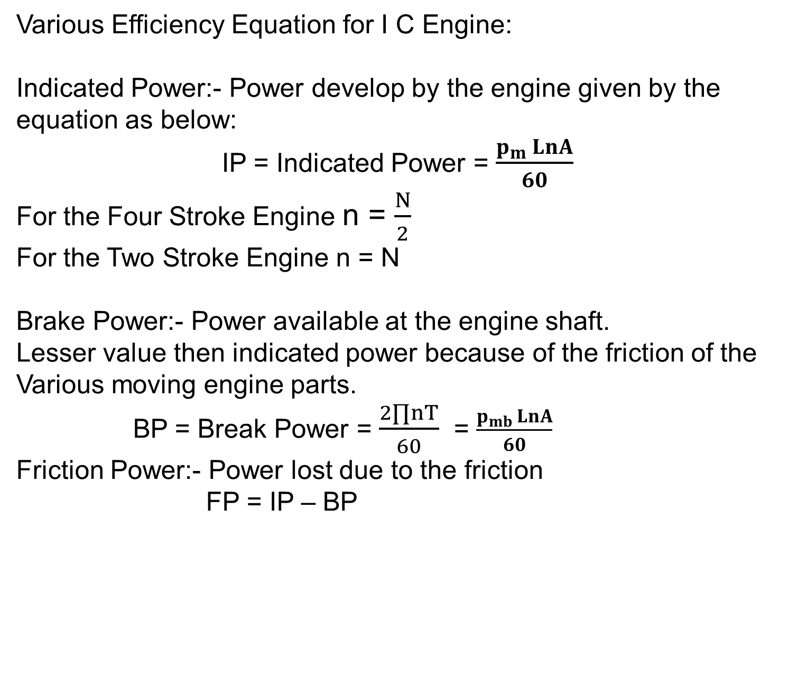
Various Efficiency Equation for I C Engine:
Indicated Power:- Power develop by the engine given by the equation as below:
IP = Indicated Power = $\frac{p_{m }LnA}{60}$
For the Four Stroke Engine n = $\frac{N}{2}$
For the Two Stroke Engine n = N
Brake Power:- Power available at the engine shaft.
Lesser value then indicated power because of the friction of the
Various moving engine parts.
BP = Break Power = $\frac{2∏nT}{60}$ = $\frac{p_{mb }LnA}{60}$
Friction Power:- Power lost due to the friction
FP = IP – BP

Slide 80
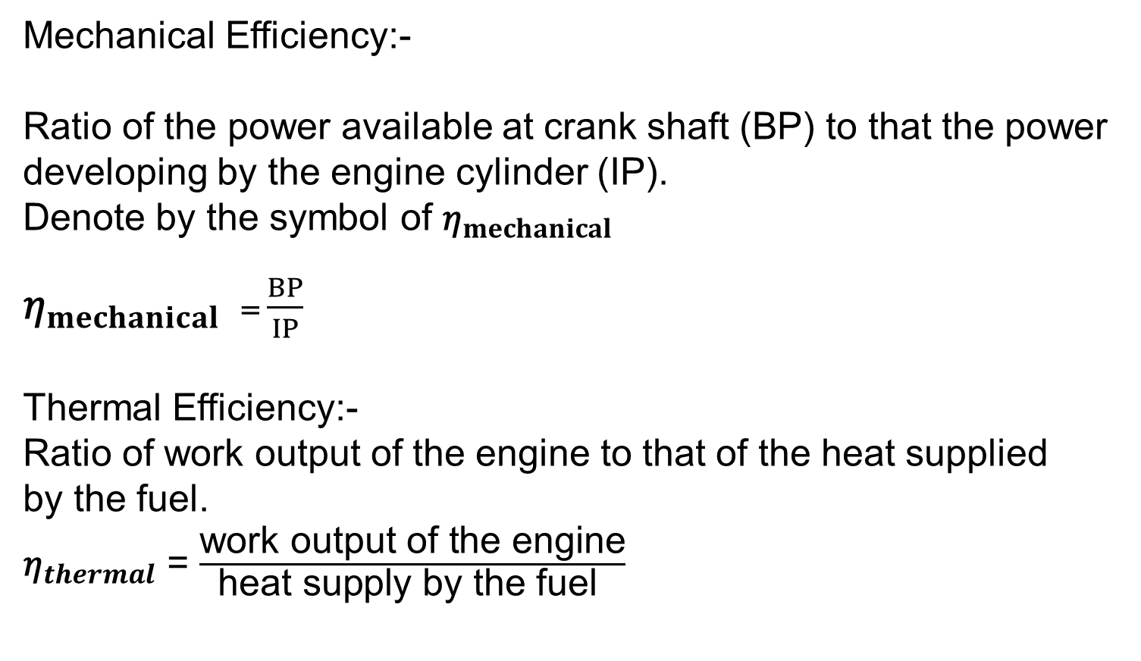
Mechanical Efficiency:-
Ratio of the power available at crank shaft (BP) to that the power
developing by the engine cylinder (IP).
Denote by the symbol of ${\text{η}}_{mechanical}$
${\text{η}}_{mechanical}$ = $\frac{BP}{IP}$
Thermal Efficiency:-
Ratio of work output of the engine to that of the heat supplied
by the fuel.
${\text{η}}_{thermal}$ = $\frac{\text{work} \text{output} \text{of} \text{the} \text{engine}}{\text{heat} \text{supply} \text{by} \text{the} \text{fuel} }$

Slide 81
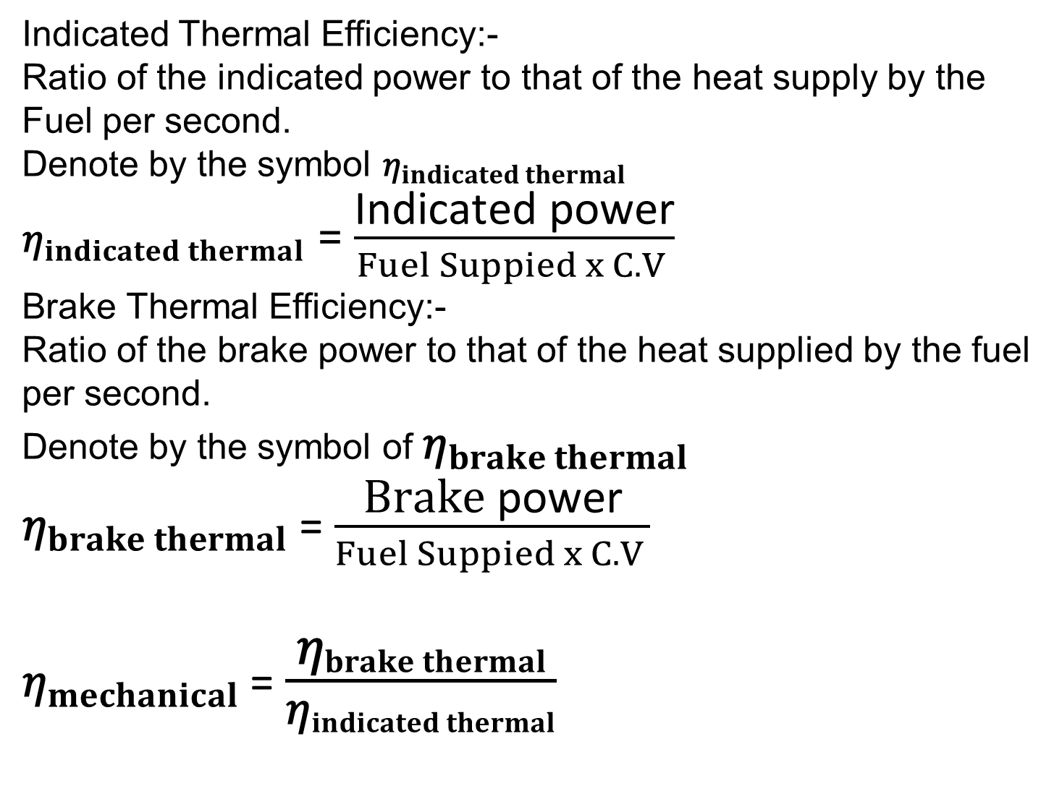
Indicated Thermal Efficiency:-
Ratio of the indicated power to that of the heat supply by the
Fuel per second.
Denote by the symbol ${\text{η}}_{indicated thermal}$
${\text{η}}_{indicated thermal}$ = $\frac{\text{I}\text{ndicated} \text{power}}{Fuel Suppied x C.V }$
Brake Thermal Efficiency:-
Ratio of the brake power to that of the heat supplied by the fuel per second.
Denote by the symbol of ${\text{η}}_{brake thermal}$
${\text{η}}_{brake thermal}$ = $\frac{\text{Brake} \text{power}}{Fuel Suppied x C.V }$
${\text{η}}_{mechanical}$ = $\frac{{\text{η}}_{brake thermal}}{{\text{η}}_{indicated thermal}}$

Slide 82
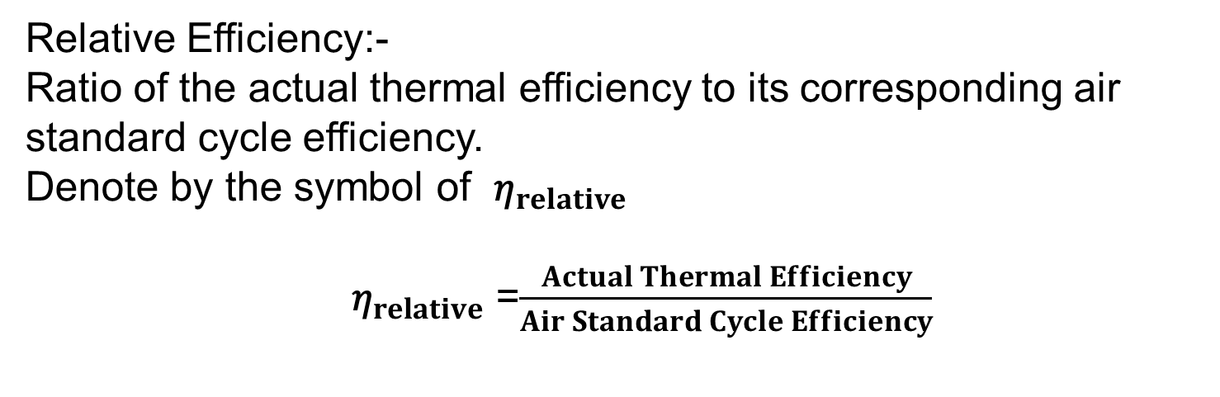
Relative Efficiency:-
Ratio of the actual thermal efficiency to its corresponding air standard cycle efficiency.
Denote by the symbol of ${\text{η}}_{relative}$
${ \text{η}}_{relative}$ =$\frac{Actual Thermal Efficiency}{Air Standard Cycle Efficiency}$

Slide 83
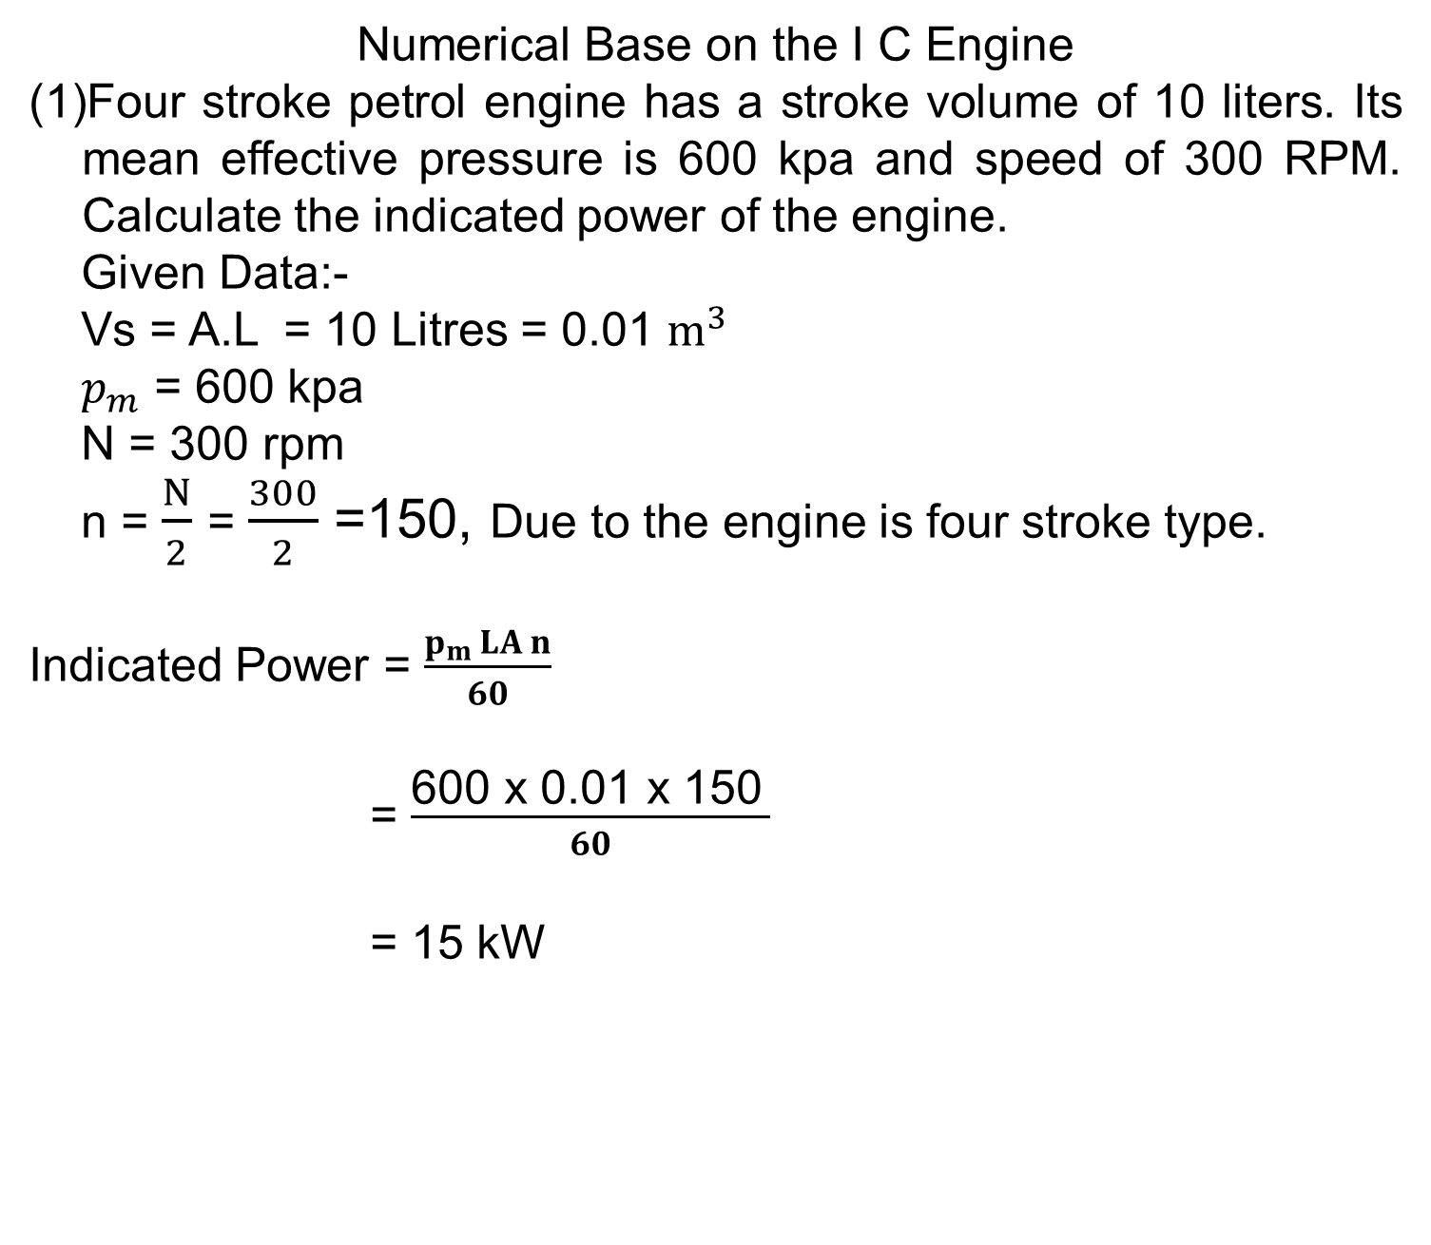
Numerical Base on the I C Engine
Four stroke petrol engine has a stroke volume of 10 liters. Its mean effective pressure is 600 kpa and speed of 300 RPM. Calculate the indicated power of the engine.
Given Data:-
Vs = A.L = 10 Litres = 0.01 $m^{3}$
$p_{m}$ = 600 kpa
N = 300 rpm
n = $\frac{N}{2}$ = $\frac{300}{2}$ =150, Due to the engine is four stroke type.
Indicated Power = $\frac{p_{m }LA n}{60}$
= $\frac{\text{600} \text{x} \text{0.01} \text{x}\text{ 150} }{60}$
= 15 kW

Slide 84
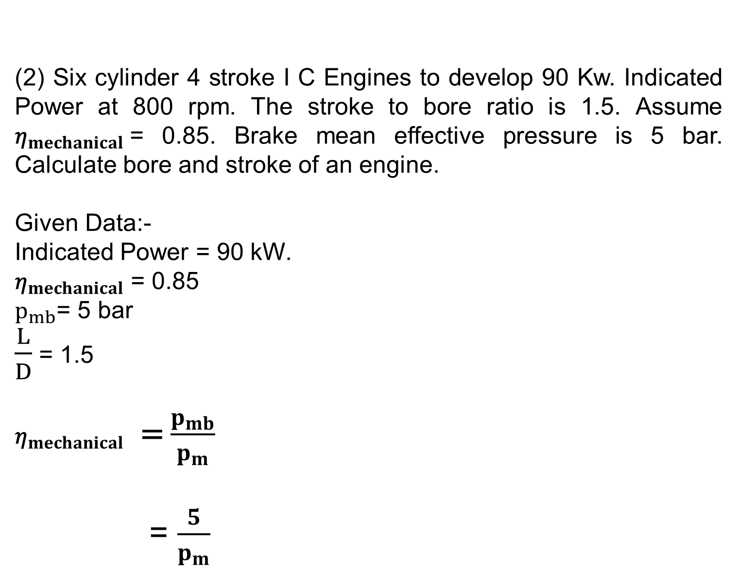
(2) Six cylinder 4 stroke I C Engines to develop 90 Kw. Indicated Power at 800 rpm. The stroke to bore ratio is 1.5. Assume ${\text{η}}_{mechanical}$= 0.85. Brake mean effective pressure is 5 bar. Calculate bore and stroke of an engine.
Given Data:-
Indicated Power = 90 kW.
${\text{η}}_{mechanical}$ = 0.85
$p_{mb}$= 5 bar
$\frac{L}{D}$ = 1.5
${\text{η}}_{mechanical}$ = $\frac{p_{mb}}{p_{m}}$
= $\frac{5}{p_{m}}$

Slide 85
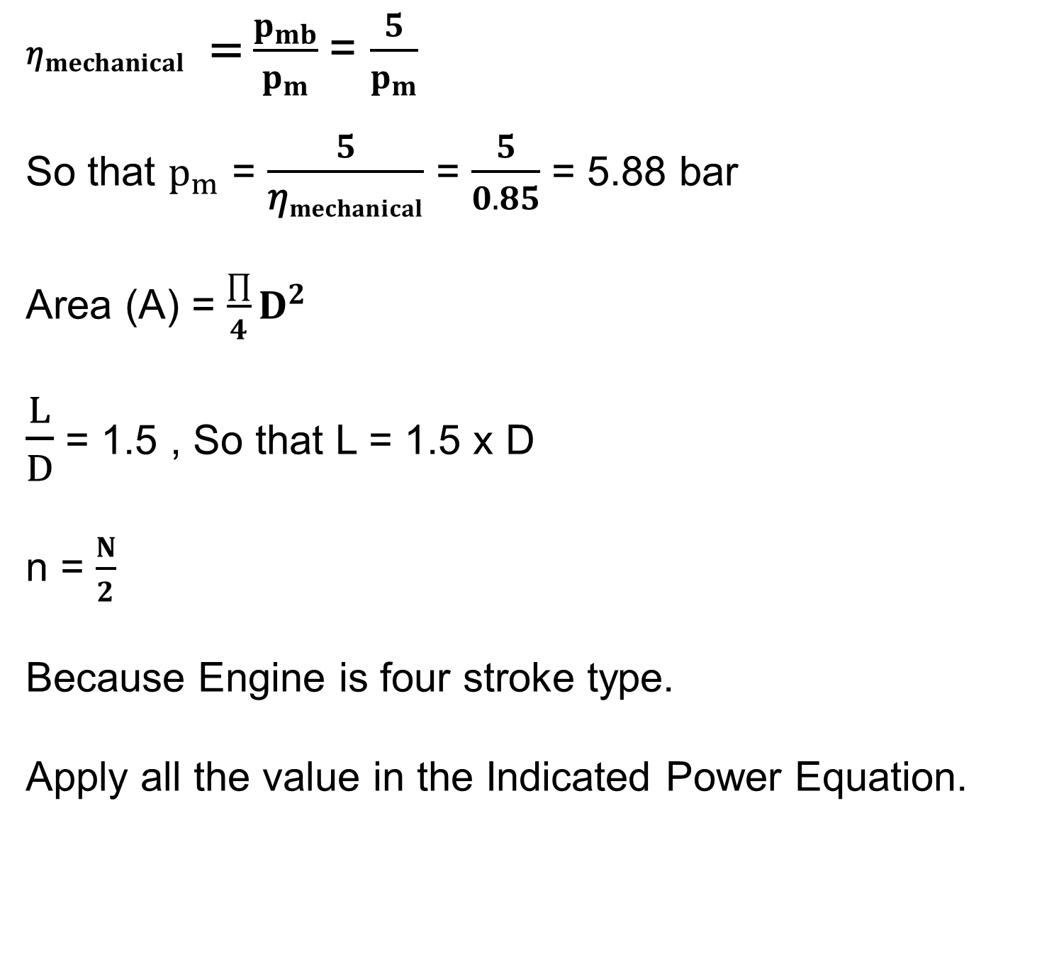
${\text{η}}_{mechanical}$ = $\frac{p_{mb}}{p_{m}}$= $\frac{5}{p_{m}}$
So that $p_{m}$ = $\frac{5}{{\text{η}}_{mechanical}}$ = $\frac{5}{0.85}$ = 5.88 bar
Area (A) = $\frac{∏}{4}D^{2}$
$\frac{L}{D}$ = 1.5 , So that L = 1.5 x D
n = $\frac{N}{2}$
Because Engine is four stroke type.
Apply all the value in the Indicated Power Equation.

Slide 86
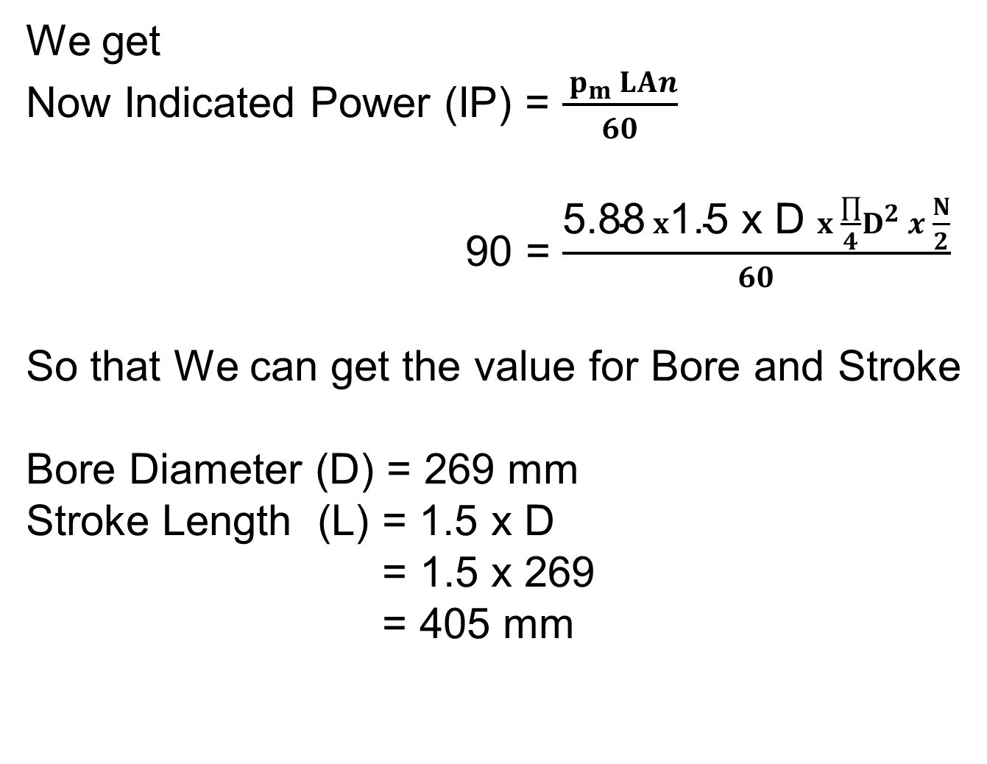
We get
Now Indicated Power (IP) = $\frac{{ p}_{m }LAn}{60}$
90 = $\frac{\text{5.88} x\text{1.5 }\text{x} \text{D} x \frac{∏}{4}D^{2} x \frac{N}{2}}{60}$
So that We can get the value for Bore and Stroke
Bore Diameter (D) = 269 mm
Stroke Length (L) = 1.5 x D
= 1.5 x 269
= 405 mm

Slide 87
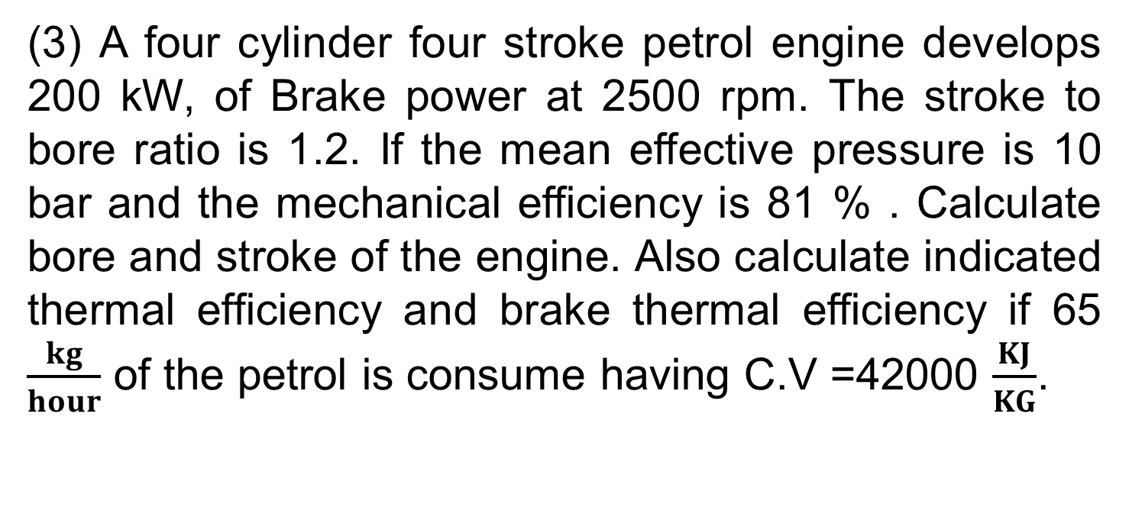
(3) A four cylinder four stroke petrol engine develops 200 kW, of Brake power at 2500 rpm. The stroke to bore ratio is 1.2. If the mean effective pressure is 10 bar and the mechanical efficiency is 81 % . Calculate bore and stroke of the engine. Also calculate indicated thermal efficiency and brake thermal efficiency if 65 $\frac{kg}{hour}$ of the petrol is consume having C.V =42000 $\frac{KJ}{KG}$.

Slide 88

Given Data:
No of Cylinder = 4
Brake Power = 200 Kw
$\frac{L}{D}$ = 1.2
$η_{m}$ = 81%
C.V = 42000 $\frac{KJ}{KG}$
n= $\frac{N}{2}$
N = 2500 rpm
$p_{m }$= 10 bar
$m_{f }$= 65 $\frac{kg}{hour}$

Slide 89
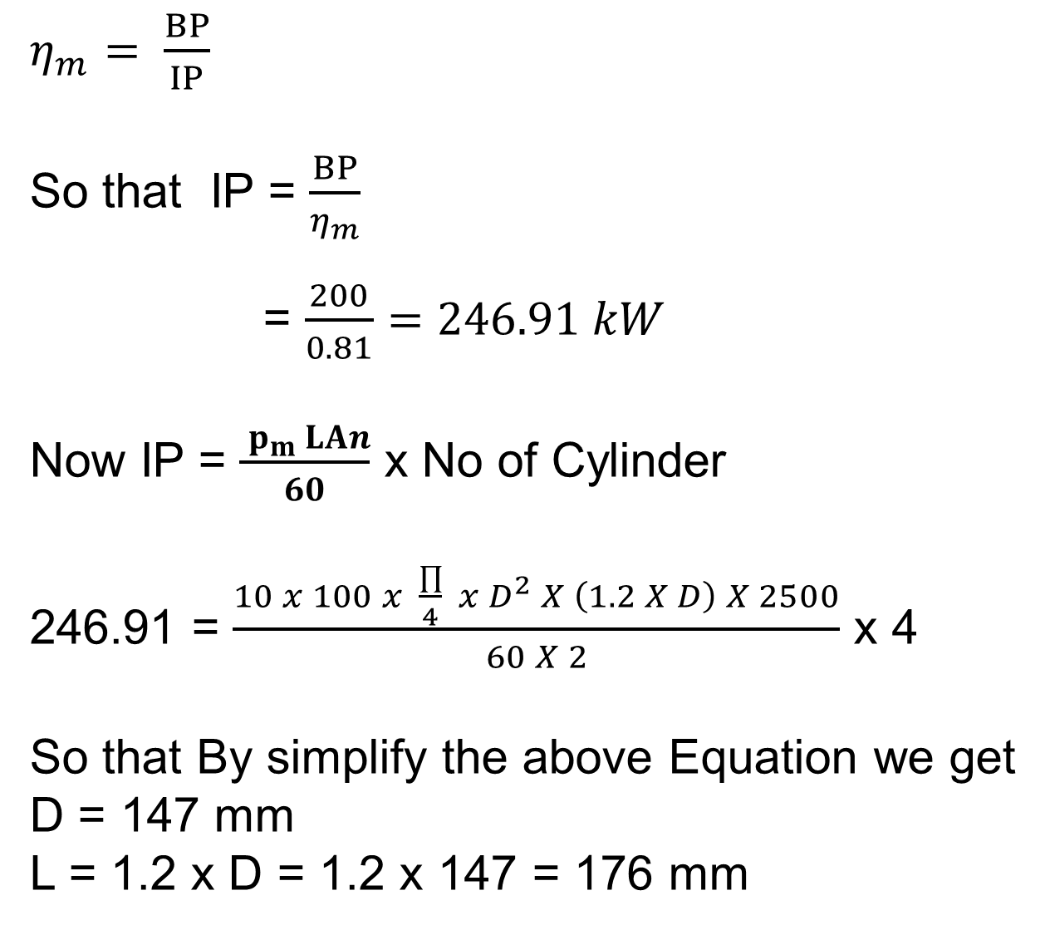
$η_{m}= \frac{BP}{IP}$
So that IP = $\frac{BP}{η_{m}}$
= $\frac{200}{0.81}=246.91 kW$
Now IP = $\frac{{ p}_{m }LAn}{60}$ x No of Cylinder
246.91 = $\frac{10 x 100 x \frac{∏}{4} x D^{2} X \left(1.2 X D\right) X 2500}{60 X 2}$ x 4
So that By simplify the above Equation we get
D = 147 mm
L = 1.2 x D = 1.2 x 147 = 176 mm

Slide 90
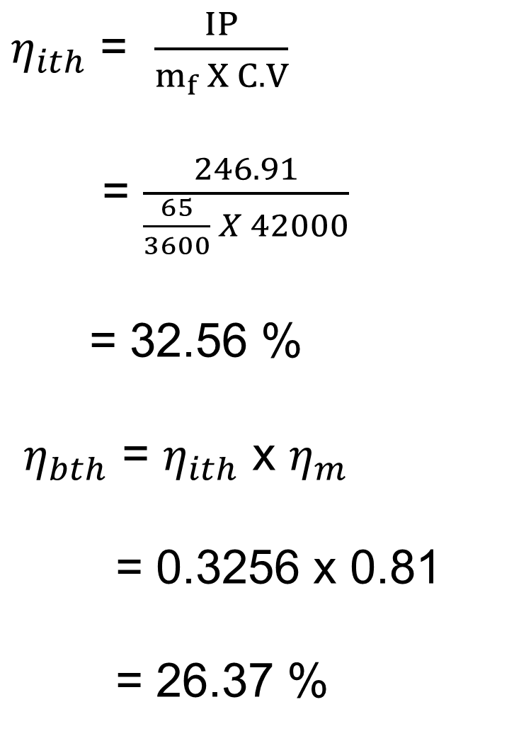
$η_{ith}$ = $\frac{IP}{m_{f} X C.V}$
= $\frac{246.91}{\frac{65}{3600} X 42000}$
= 32.56 %
$η_{bth}$ = $η_{ith}$ x $η_{m}$
= 0.3256 x 0.81
= 26.37 %

Slide 91
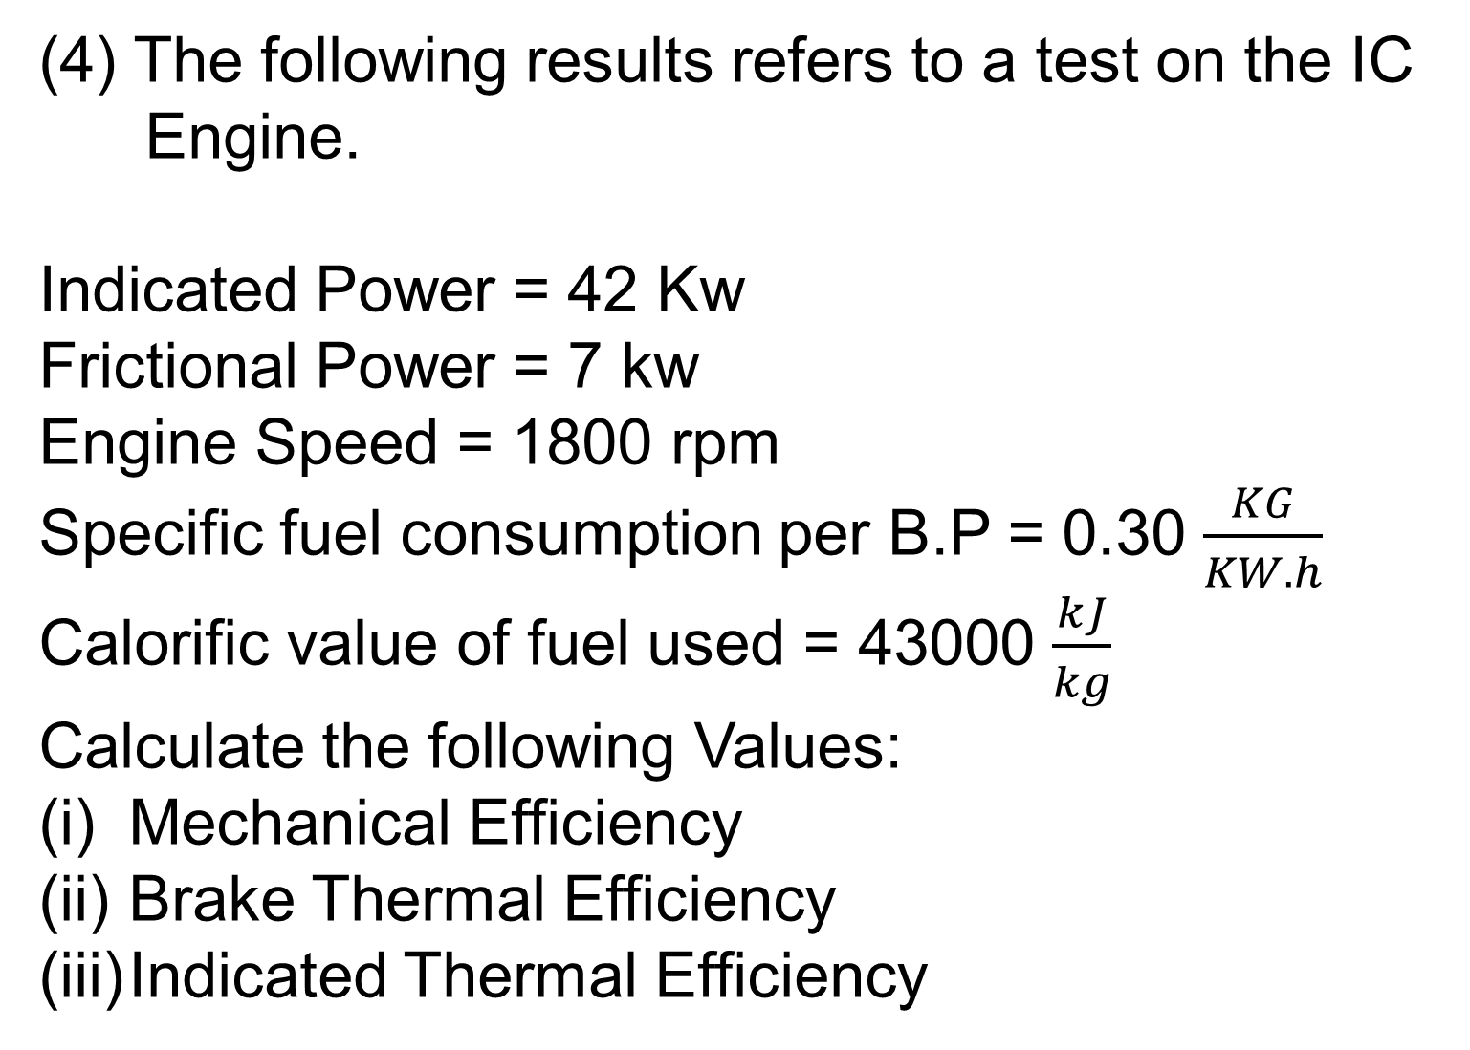
(4) The following results refers to a test on the IC
Engine.
Indicated Power = 42 Kw
Frictional Power = 7 kw
Engine Speed = 1800 rpm
Specific fuel consumption per B.P = 0.30 $\frac{KG}{KW.h}$
Calorific value of fuel used = 43000 $\frac{kJ}{kg}$
Calculate the following Values:
Mechanical Efficiency
Brake Thermal Efficiency
Indicated Thermal Efficiency

Slide 92
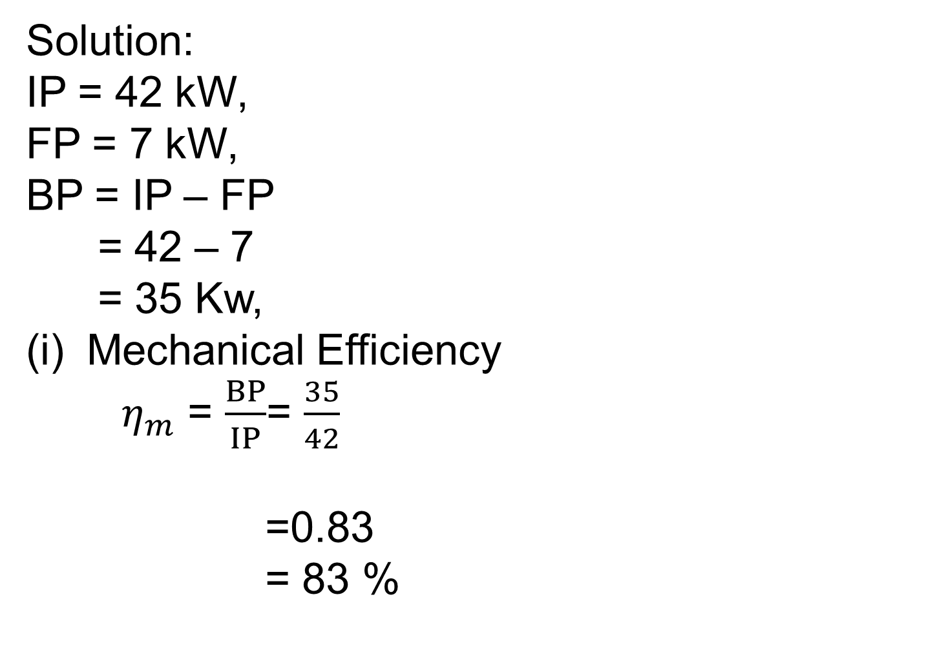
Solution:
IP = 42 kW,
FP = 7 kW,
BP = IP – FP
= 42 – 7
= 35 Kw,
Mechanical Efficiency
${\text{η}}_{m}$ = $\frac{BP}{IP}$= $\frac{35}{42}$
=0.83
= 83 %

Slide 93
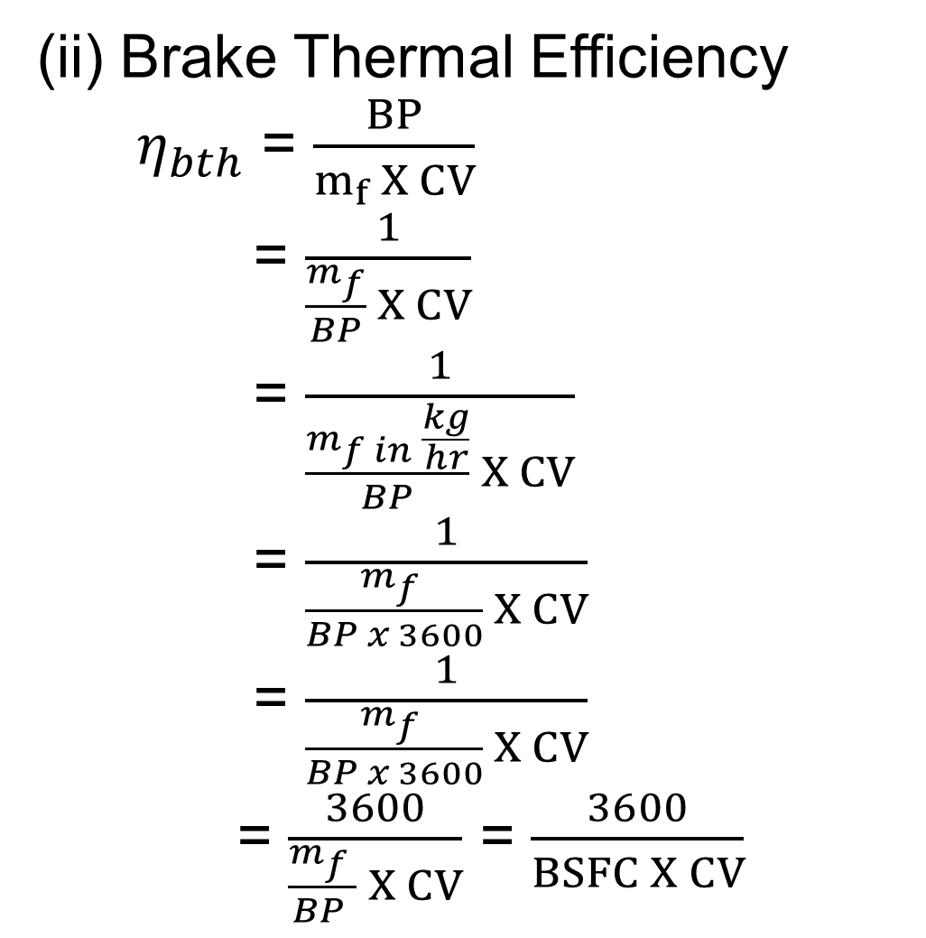
(ii) Brake Thermal Efficiency
$η_{bth}$ = $\frac{BP}{m_{f} X CV}$
= $\frac{1}{\frac{m_{f}}{BP} X CV}$
= $\frac{1}{\frac{m_{f in }\frac{kg}{hr}}{BP} X CV}$
= $\frac{1}{\frac{m_{f }}{BP x 3600} X CV}$
= $\frac{1}{\frac{m_{f }}{BP x 3600} X CV}$
= $\frac{3600}{\frac{m_{f }}{BP } X CV}$ = $\frac{3600}{BSFC X CV}$

Slide 94
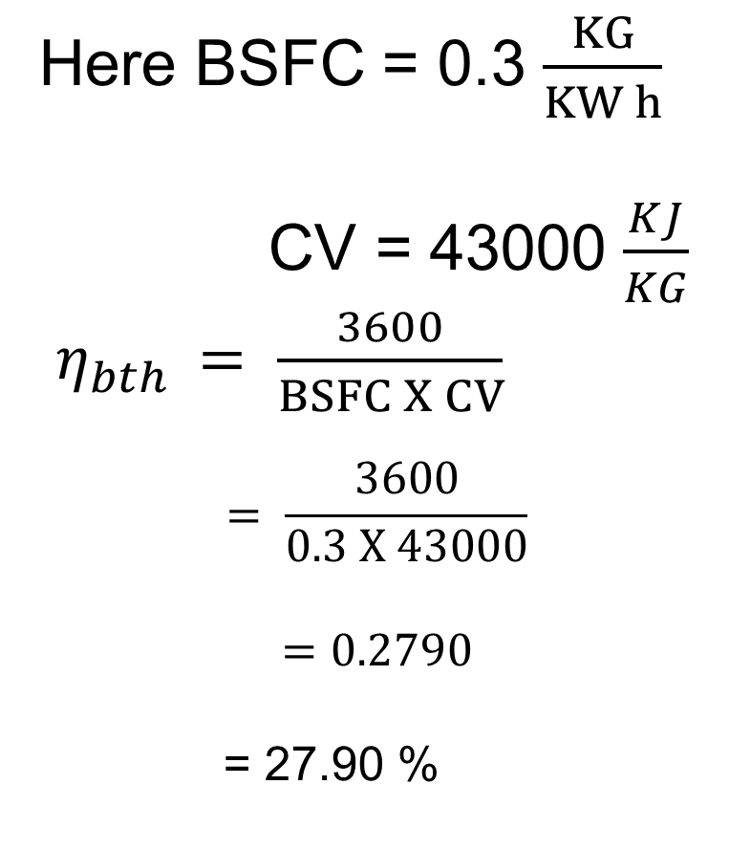
Here BSFC = 0.3 $\frac{KG}{KW h}$
CV = 43000 $\frac{KJ}{KG}$
$η_{bth }= \frac{3600}{BSFC X CV}$
$$= \frac{3600}{0.3 X 43000}$$
$$=0.2790$$
= 27.90 %

Slide 95
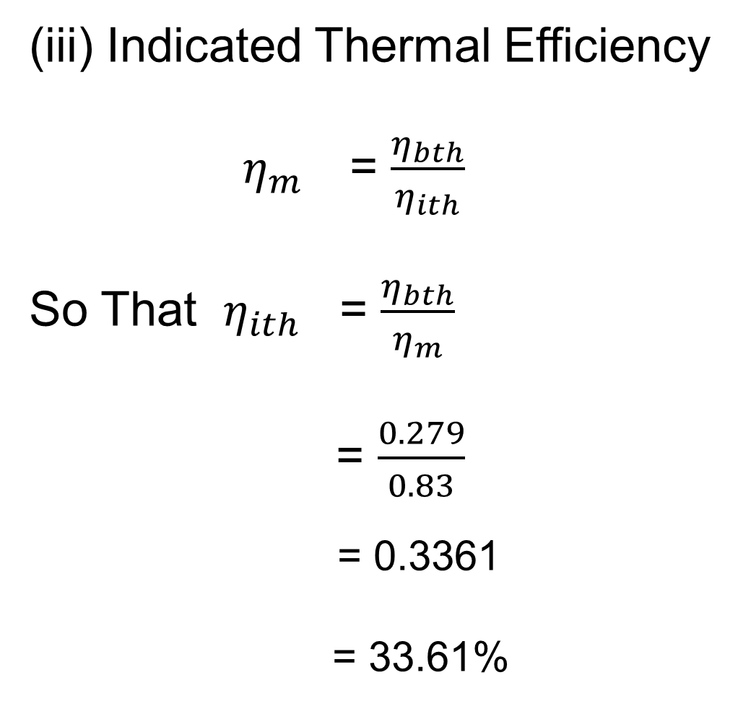
(iii) Indicated Thermal Efficiency
$η_{m }$= $\frac{η_{bth}}{η_{ith}}$
So That $η_{ith }$= $\frac{η_{bth}}{η_{m}}$
= $\frac{0.279}{0.83}$
= 0.3361
= 33.61%

Slide 96
(5) Following observations were record during a test on a single cylinder oil engine.
Bore = 300 mm
Stroke = 450 mm
Speed = 300 rpm
indicated mean effective pressure = 6 bar
Net break load = 1.5 kN
Brake drum diameter = 1.8 m
Brake rope diameter = 2 cm
Calculate the following values:
Indicated Power
Brake Power
Mechanical Efficiency

Slide 97
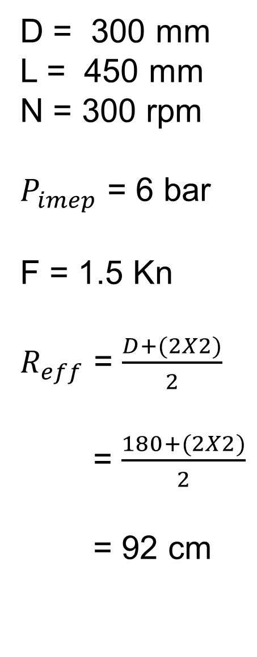
D = 300 mm
L = 450 mm
N = 300 rpm
$P_{imep}$ = 6 bar
F = 1.5 Kn
$R_{eff}$ = $\frac{D+(2X2)}{2}$
= $\frac{180+(2X2)}{2}$
= 92 cm

Slide 98

Indicated Power
IP = $\frac{{ p}_{imep }LAN}{60}$
= $\frac{{ p}_{imep }L X \frac{∏}{4} D^{2} X N}{60}$
Consider that the engine is 4 stroke type.
= $\frac{600 X 0.450 X \frac{∏}{4} x {0.3}^{2} X 300}{2 x 60}$
IP = 47.68 kw

Slide 99

(ii) Brake Power
BP = $\frac{2 X π X N X T}{60}$
= $\frac{2 X π X 300 X (F X R_{eff})}{60}$
= $\frac{2 X π X 300 X (1.5 X 0.92)}{60}$
= 43.33 Kw,

Slide 100
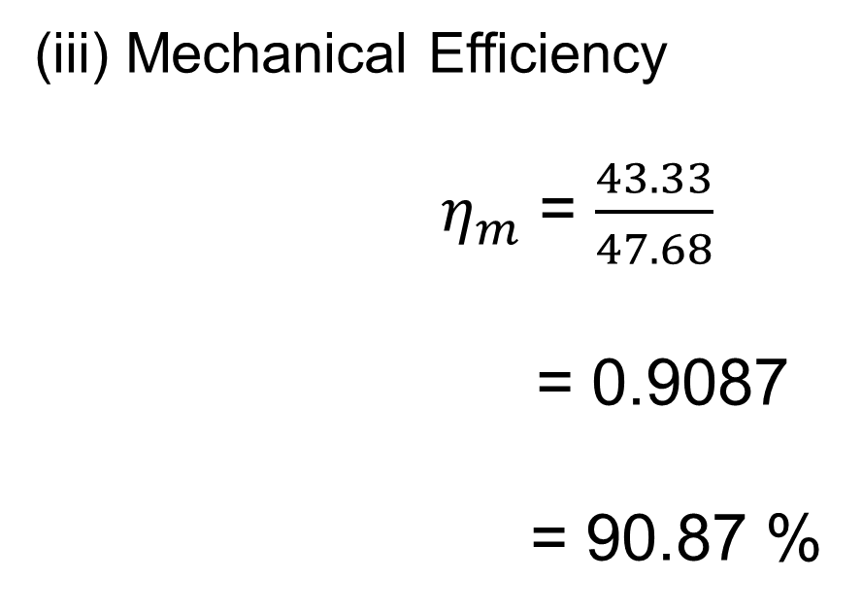
(iii) Mechanical Efficiency
${ \text{η}}_{m}$ = $\frac{43.33}{47.68}$
= 0.9087
= 90.87 %

Slide 101
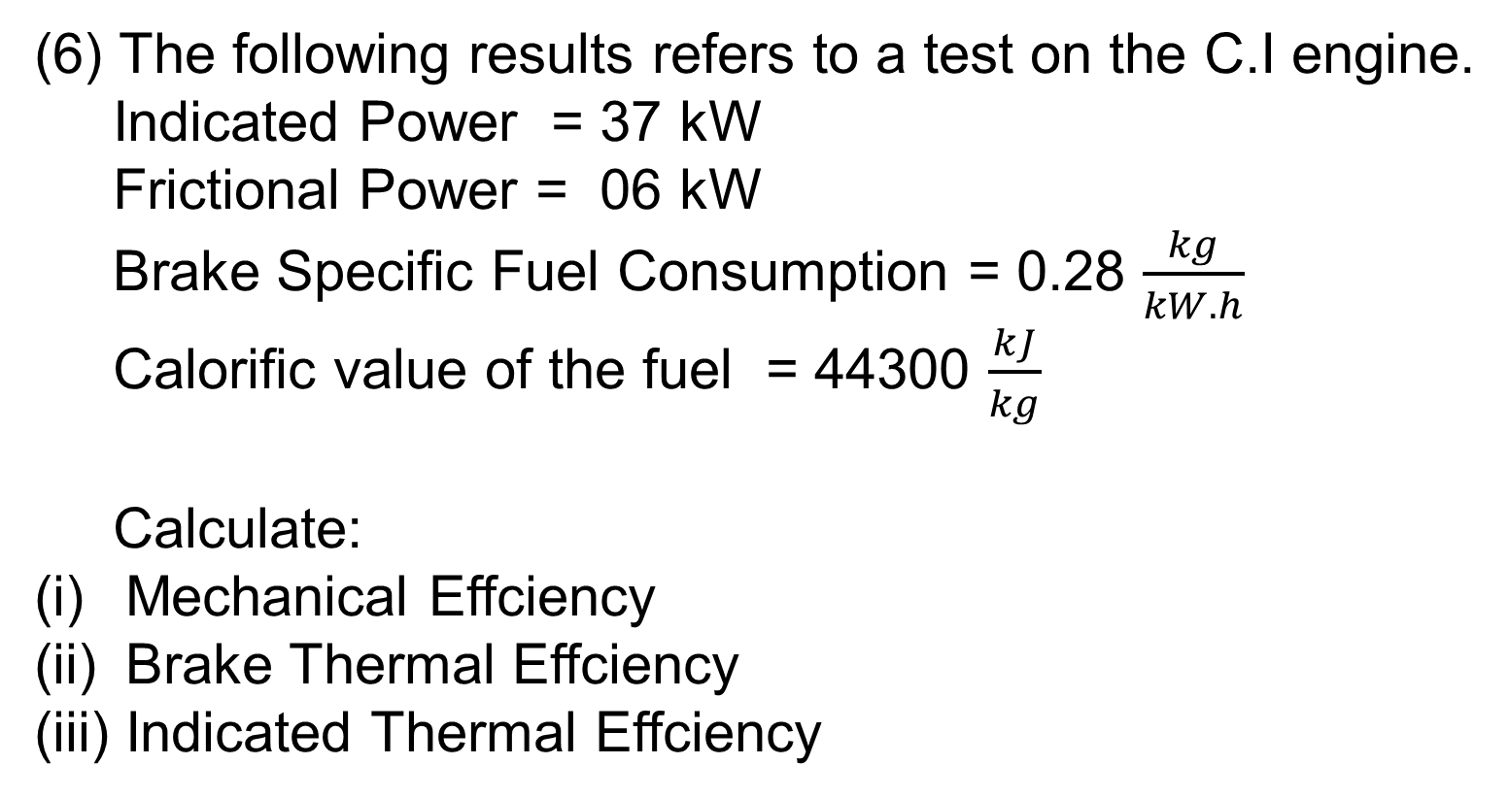
(6) The following results refers to a test on the C.I engine.
Indicated Power = 37 kW
Frictional Power = 06 kW
Brake Specific Fuel Consumption = 0.28 $\frac{kg}{kW.h}$
Calorific value of the fuel = 44300 $\frac{kJ}{kg}$
Calculate:
Mechanical Effciency
Brake Thermal Effciency
Indicated Thermal Effciency

Slide 102
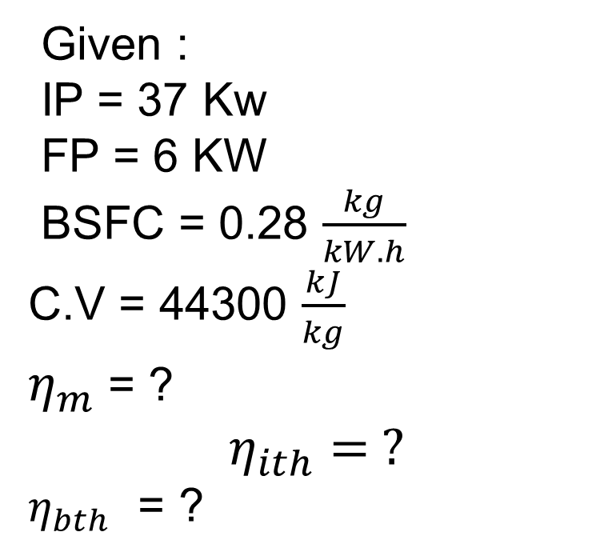
Given :
IP = 37 Kw
FP = 6 KW
BSFC = 0.28 $\frac{kg}{kW.h}$
C.V = 44300 $\frac{kJ}{kg}$
${\text{η}}_{m}$ = ?
$$η_{ith}= ?$$
$η_{bth}$ = ?

Slide 103

${\text{η}}_{m}$ = $\frac{BP}{IP}$
= $\frac{IP −FP}{IP}$
= $\frac{37−6}{37}$
= 83.78 %
BSFC = $\frac{m_{f}}{BP}$
Mf = BSFC x BP
= 0.28 X 31 = 8.68 $\frac{kg}{hr}$

Slide 104
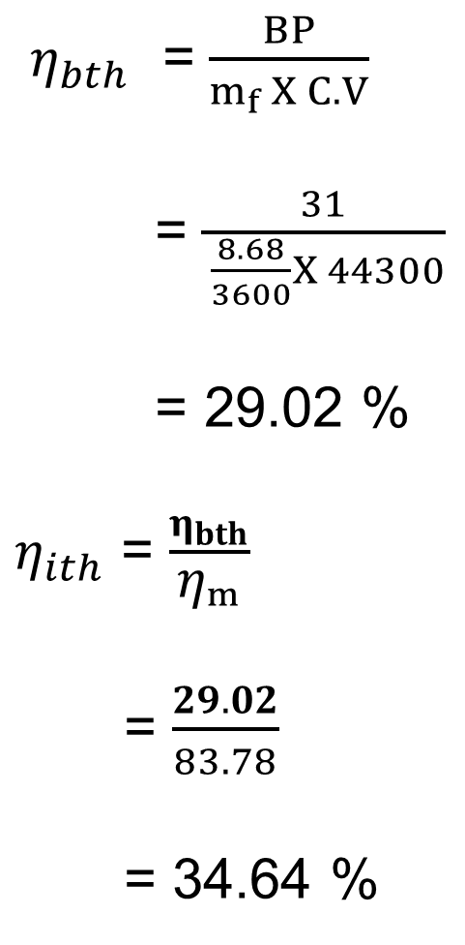
$η_{bth}$ = $\frac{BP}{m_{f} X C.V}$
= $\frac{31}{ \frac{8.68}{3600}X 44300}$
= 29.02 %
${\text{η}}_{ith}$ = $\frac{η_{bth}}{{\text{η}}_{m}}$
= $\frac{29.02}{83.78}$
= 34.64 %

Slide 105
(7) During a test on the single cylinder four stroke engine
having a compression ratio of 6, the following data is
record.
Bore = 10 cm
Stroke = 12.5 cm
imep = 2.6 bar
dead load on dynamometer = 60 N
Spring balance reading = 19 N
Effective radius of the flywheel = 40 cm
Fuel consumption = 1 kg/hr
Calorific Value of fuel = 42000 kj/kg
Speed =2000 RPM
Determine its indicated power, brake power,
mechanical efficiency, over all efficiency, air
standard cycle efficiency, relative effeciency

Slide 106
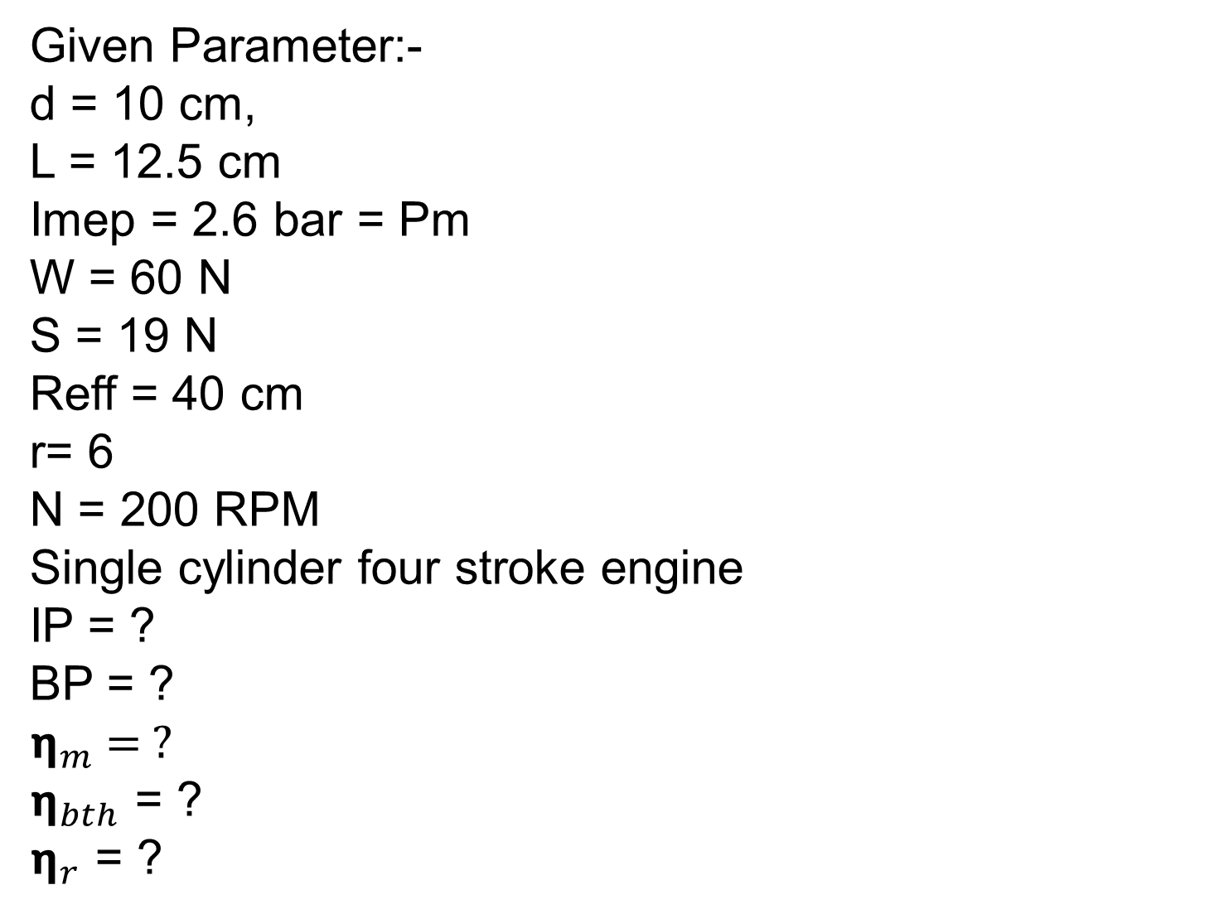
Given Parameter:-
d = 10 cm,
L = 12.5 cm
Imep = 2.6 bar = Pm
W = 60 N
S = 19 N
Reff = 40 cm
r= 6
N = 200 RPM
Single cylinder four stroke engine
IP = ?
BP = ?
${\text{η}}_{m}$ = ?
${\text{η}}_{bth}$ = ?
${\text{η}}_{r}$ = ?

Slide 107
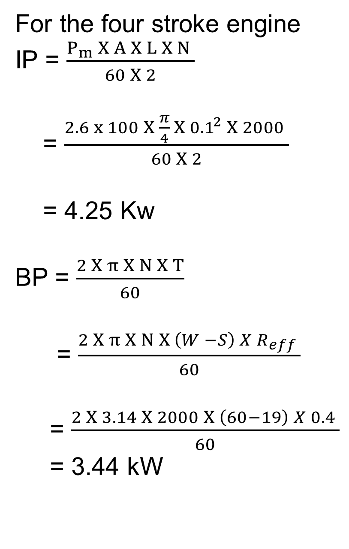
For the four stroke engine
IP = $\frac{P_{m} X A X L X N }{60 X 2}$
= $\frac{2.6 x 100 X \frac{π}{4} X {0.1}^{2} X 2000 }{60 X 2}$
= 4.25 Kw
BP = $\frac{2 X π X N X T}{60}$
= $\frac{2 X π X N X \left(W −S\right) X R_{eff} }{60}$
= $\frac{2 X 3.14 X 2000 X \left(60−19\right) X 0.4 }{60}$
= 3.44 kW

Slide 108
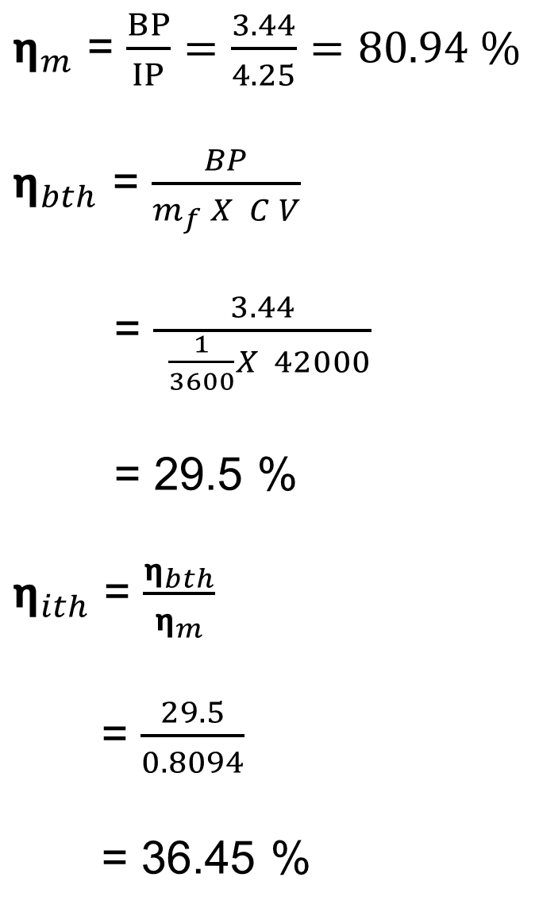
$η_{m}$ = $\frac{BP}{IP}=\frac{3.44}{4.25}=80.94 \%$
$η_{bth}$ = $\frac{BP}{m_{f} X C V}$
= $\frac{3.44}{ \frac{1}{3600}X 42000}$
= 29.5 %
$η_{ith}$ = $\frac{η_{bth}}{η_{m}}$
= $\frac{29.5}{0.8094}$
= 36.45 %

Slide 109
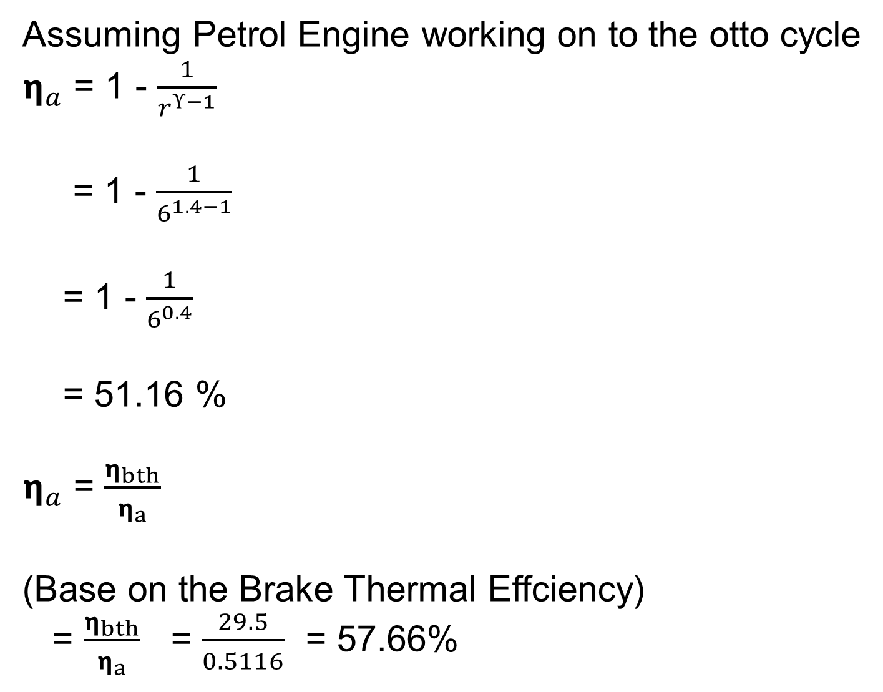
Assuming Petrol Engine working on to the otto cycle
$η_{a}$ = 1 - $\frac{1}{r^{ϒ−1}}$
= 1 - $\frac{1}{6^{1.4−1}}$
= 1 - $\frac{1}{6^{0.4}}$
= 51.16 %
$η_{a}$ = $\frac{η_{bth}}{η_{a}}$
(Base on the Brake Thermal Effciency)
= $\frac{η_{bth}}{η_{a}}$ = $\frac{29.5}{0.5116}$ = 57.66%

